Slide 1

Enhancing Aerospace Supply Chain Resilience: A Predictive Analytics Approach to Mitigate Lead-Time Volatility
Parmbir Singh
Course 497 Technology/Computing Capstone
2026 BS in Computer Science
School of Technology & Computing (STC)
1
Notes:
CityU logo cannot be deleted.
Design can be modified for your preference.

Slide 2
Agenda
Problem Statement
Motivation
Background
Related Work
Approach
Design
Implementation
Data Collection
Data Analysis
Findings
Conclusions
Future Work
Key References
Q&A

Slide 3
Abstract
Aerospace supply chains face lead-time volatility due to reactive planning
Limited multi-tier supplier visibility causes production instability
Literature shows outdated models are insufficient
Proposed solution: predictive analytics framework
Goal: shift from reactive response to proactive forecasting
3
Notes:
This project examines instability in aerospace supply chains caused by reactive planning and limited supplier visibility.
Research showed that traditional models relying on historical averages have contributed to lead-time volatility and production delays.
My capstone proposes a predictive analytics framework that uses supplier and logistics data to forecast potential disruptions before they affect assembly operations.

Slide 4
Keywords
Aerospace Supply Chain
Predictive Analytics
Lead-Time Volatility
Machine Learning
Supply Chain Risk
Digital Supply Chain
4

Slide 5
Problem Statement
Aerospace supply chains rely on reactive planning and historical averages.
Limited supplier visibility causes lead-time volatility.
Delays in minor components stall entire aircraft production.
5
Notes:
The Gap: A mismatch between "as-is" reactive logistics and "to-be" proactive resilience
Current Issue: Reliance on historical averages fails to account for real-time geopolitical and logistical shifts
Impact: Lead-time volatility results in assembly line stoppages and millions in damages
Proposed Solution: Accurate machine learning models to reduce downtime by an estimated 10%

Slide 6
Motivation
Critical Need: Minor component delays can stall the production of an entire aircraft
Academic Driver: Linear supply chain models are obsolete in today's global volatility
Business Goal: Creating a scalable framework that converts complex data into practical insights

Slide 7
Background
Reviewed government, industry, and professional sources
Identified evidence of reactive supply chain practices
Found repeated reports of supplier delays and visibility gaps
Identified emerging use of predictive analytics in aerospace
7

Slide 8
Background - Evidence
GAO: limited multi-tier supplier visibility
Leeham: Boeing & Airbus production slowdowns
Reuters: supplier capacity affecting output goals
Industry moving toward predictive tools (Trax, EY)
8

Slide 9
Related Work
Outdated reactive aerospace supply chains
Lead-time volatility and production delays
Supplier capacity constraints across tiers
Predictive analytics as emerging solution
9

Slide 10
Related Word As-Is State
Reactive problem solving instead of proactive planning
Component shortages affecting schedules
Production ramp-ups delayed repeatedly
Airlines adjusting delivery expectations
10

Slide 11
Related Work – To-Be State
Machine learning for supplier and inventory forecasting
Digital twins for production scenario modeling
Data-driven visibility across supply networks
Shift from reactive to predictive decision-making
11

Slide 12
Related Work – Key Takeaway
Evidence shows aerospace supply chains are fragile
Root cause is lack of predictive visibility
Literature supports analytics-driven transformation
12

Slide 13
Approach Overview
Develop predictive analytics framework for supplier risk detection
Use historical lead-time data to identify volatility patterns
Apply machine learning models for disruption forecasting
Generate supplier risk scores to support planning decisions
Shift from reactive mitigation to proactive forecasting
13
Notes:
This slide introduces the technical direction of the project. The goal is not just to analyze delays but to forecast risk before disruptions impact production.

Slide 14
System Design
Data Ingestion
Supplier delivery history
Lead-time performance data
Data Processing
Cleaning & normalization
Feature engineering
Predictive Modeling
Baseline statistical models
Machine learning forecasting
Risk Output
Supplier risk scores
Lead-time volatility indicators
14
Notes:
This architecture follows a modular pipeline. Each stage builds toward generating interpretable risk indicators.

Slide 15
Implementation Plan
Phase 1
Develop representative supplier dataset
Perform exploratory data analysis (EDA)
Phase 2
Build baseline forecasting models
Evaluate predictive performance
Phase 3
Implement ML models
Compare accuracy & refine
Phase 4
Deploy outputs to reporting dashboard
15
Notes:
Implementation is iterative. Models will be tested and refined before visualization.

Slide 16
Technologies Used
Primary Stack
Databricks (Python notebooks)
Power BI (dashboard & visualization)
GitHub (version control & documentation)
16
Notes:
Databricks provides the modeling environment. Power BI converts outputs into operational dashboards. MLflow and Delta Lake may be used for governance and reproducibility.

Slide 17
Data Collection
Data Source (Simulated / Structured Sample Data)
Supplier delivery timestamps
Historical lead-time records
Delay frequency indicators
Production scheduling metrics
Goal
Capture patterns of volatility
Identify recurring disruption signals
17

Slide 18
Data Analysis
Time-Series Comparison of Production and Supply Pressure
Dual-axis visualization highlights trend alignment
Both variable increase over time indicates sustained supply chain stress
18
Notes:
This analysis compares aerospace production with global supply chain pressure using a dual-axis time-series visualization. The blue line represents production, while the red dashed line represents supply pressure. The graph shows that both variables trend upward over time. This suggests that production growth is occurring alongside increasing supply chain stress. Rather than isolated disruptions, the data indicates sustained pressure within the system.

Slide 19
Data Preparation in Databricks
Rising supply pressure
Production continues increasing
Indicates sustained system stress
19
Notes:
The key takeaway from this analysis is that supply chain pressure appears to be persistent rather than temporary. As pressure increases, production continues to rise, suggesting that manufacturers are operating under ongoing constraints. This indicates that supply chain instability is a structural issue rather than a short-term disruption.

Slide 20
Aerospace Supply Chain Dataset 1
Use engineered features
Forecast disruption risk
Build PowerBI dashboard
20
Notes:
Based on this analysis, the next phase of the project is to move into predictive modeling. The goal is to use the engineered dataset to forecast disruption risk and better understand how supply chain pressure impacts production. This will also be supported by visualization in Power BI dashboards to make insights more actionable.

Slide 21
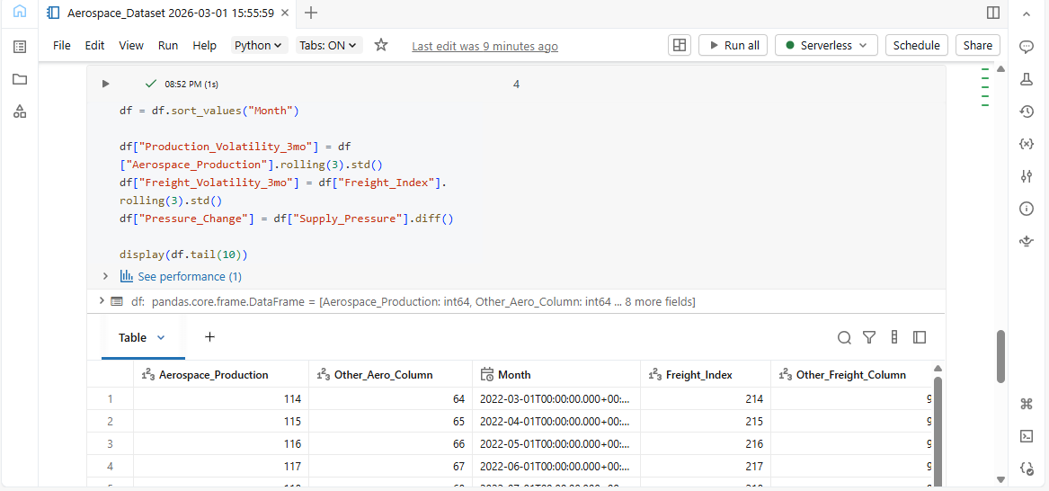
Aerospace Supply Chain Dataset 2
21
Notes:
The dataset created this week combines three economic indicators that reflect different aspects of the aerospace supply chain. The aerospace production index represents manufacturing output, the freight index represents logistics activity, and the supply chain pressure index captures global disruptions. These datasets were merged into a single monthly dataset that can be used to explore relationships between supply chain pressure and aerospace production performance.

Slide 22
Feature Engineering & Next Steps
Additional analytical indicators created:
Production volatility (3-month rolling deviation)
Freight volatility (3-month rolling deviation)
Supply chain pressure change
Purpose:
Identify instability patterns in aerospace supply chains.
Next step:
Use Power BI to create visual dashboards and explore relationships between these indicators
22
Notes:
In addition to merging the datasets, I also created additional features that measure volatility. These include rolling standard deviations for production and freight data as well as changes in supply chain pressure. These features help identify periods of instability rather than only looking at raw values. Next week, I will use Power BI to visualize the dataset and explore potential correlations between these indicators.

Slide 23
Key Findings
Aerospace production shows a steady upward trend
Supply chain pressure increases alongside production
Monthly pressure changes reveal significant volatility
Positive correlation exists between production and supply pressure
Increased production is associated with higher supply chain strain
23

Slide 24

Data Visualizations & Analysis
24
Notes:
LEFT:
Graph 1 (Trend)
RIGHT:
Graph 2 (Volatility)
BOTTOM:
Graph 3 (Scatter / Correlation)
These visualizations show that while aerospace production is increasing, supply chain pressure is also rising. The volatility graph reveals that this pressure is unstable, with frequent fluctuations. The correlation analysis confirms that higher production levels are associated with increased strain on the supply chain. This supports the need for predictive analytics to anticipate disruptions rather than reacting to them.

Slide 25
GitHub
GitHub Repository:
https://github.com/AkQuik559/Winter-2025-CS-497-Capstone-Project-Proposal-Enhancing-Aerospace-Supply-Chain-Resilience
Includes:
Data processing workflows
Databricks notebooks
Project documentation
25

Slide 26
References
Bednarski et al. (2025)
Deloitte (2023-2025)
Douaioui et al (2024)
Omar (2025)
GAO (2024)
Leeham News (2025)
McKinsey (2021
Reuters (2, 2024)
Trax Technologies (2025)
EY (2025)
26

Slide 27


Q&A

Slide 28
Extra Slide for later
Extra Slide
28

